Slide 2

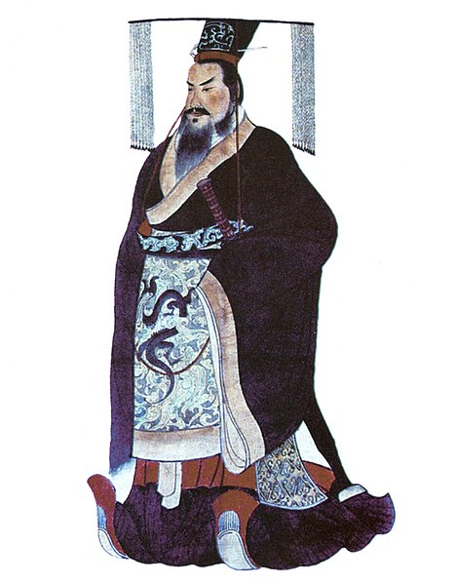
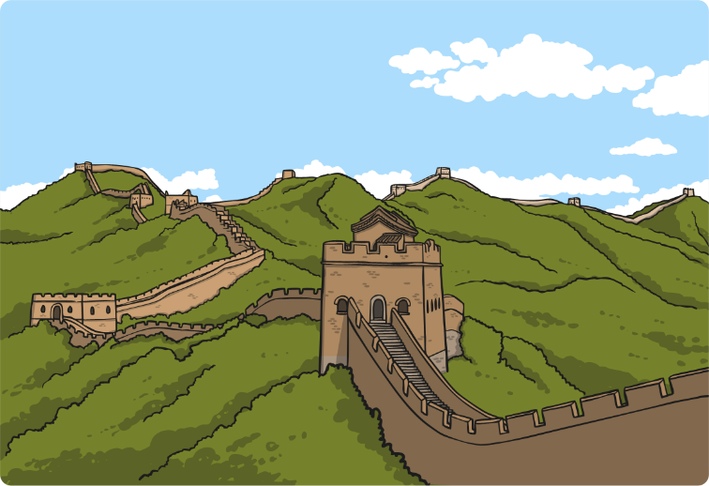
The First Emperor
Qin Shi Huang became the first emperor of a united China, in 220 BC.
Qin Shi Huang ruled until his death in 210 BC.
Qin Shi Huang ordered the construction of the Terracotta Army because he wanted to discover the secret of immortality.
During his reign, he was responsible for the first version of the Great Wall of China.
Click on the points of the timeline.

Slide 3
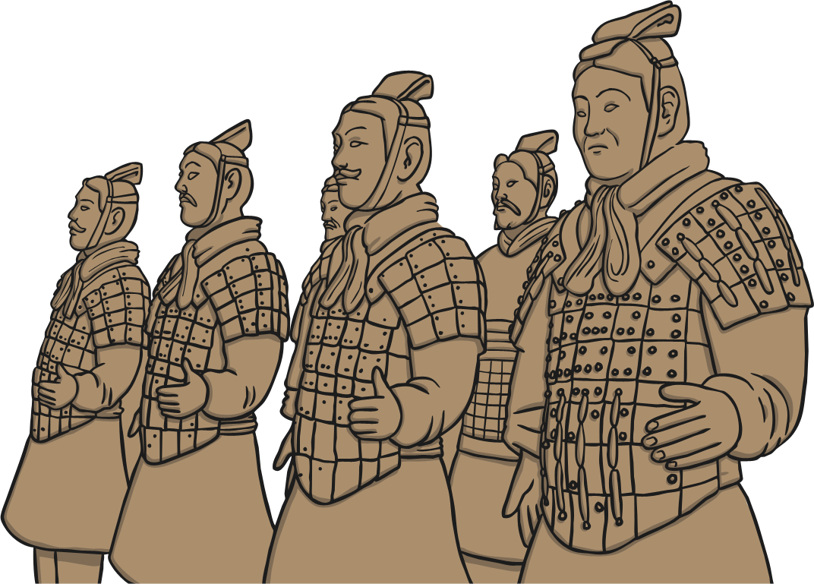
Protection After Death
The army was built to protect Qin in the afterlife. It would take almost forty years to build. After he died, production came to an abrupt end because there
was a war.

Slide 4


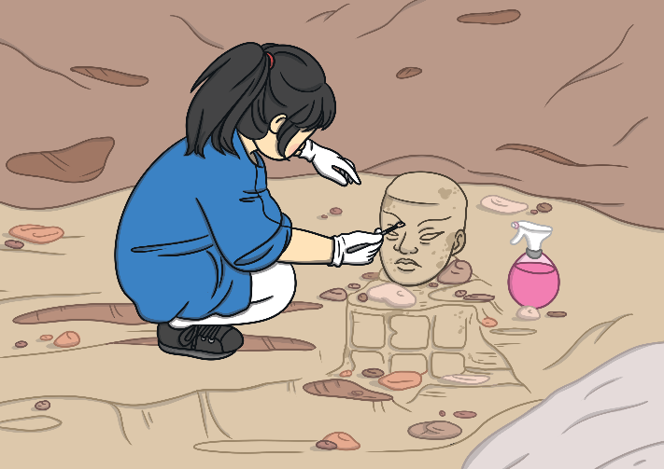
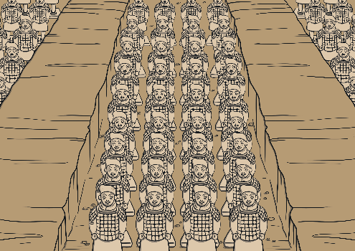
Discovery of the Terracotta Army
In March 1974, farmers in Xian, China, were digging a well. While digging they discovered a life-size model of a warrior made from clay.
The farmers told the Chinese government and they sent officials to come and inspect the area.
After more exploring, three huge vaults were found. Inside they found around 8000 lifesize models of warriors. These models were made of clay.

Slide 5
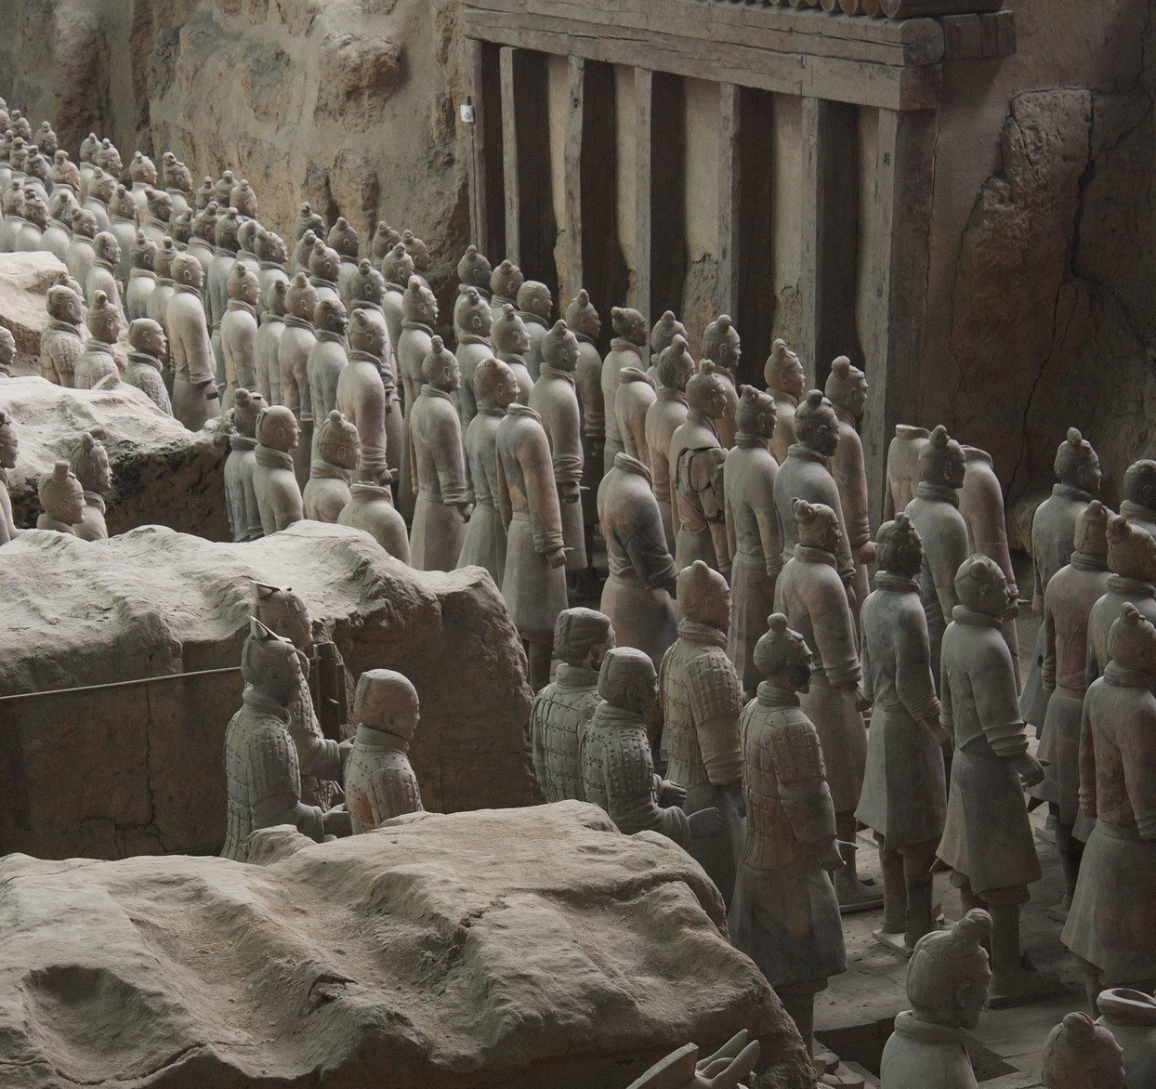
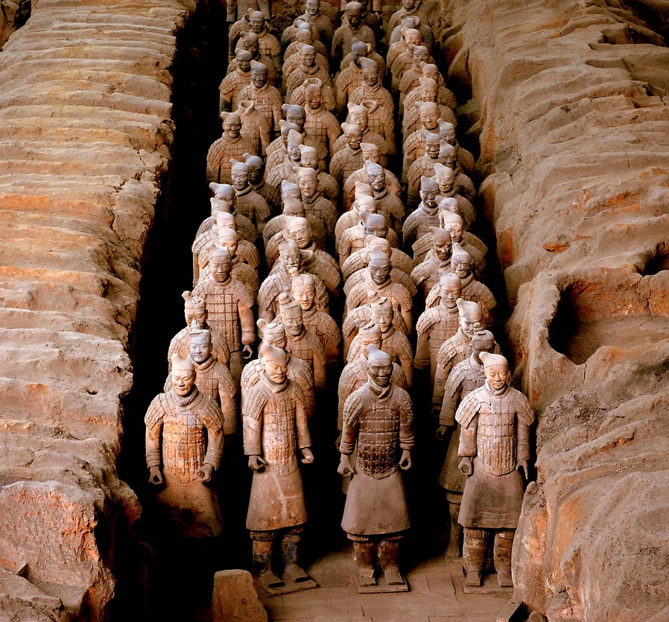
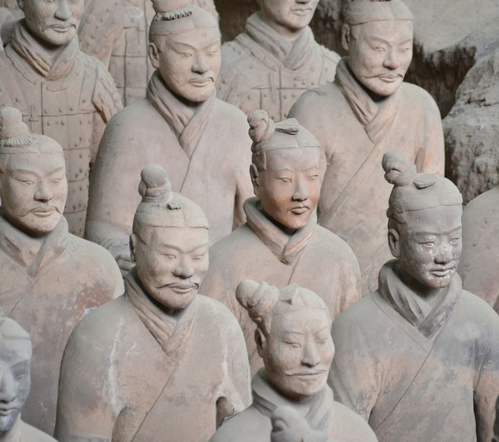
The Terracotta Army
What are your thoughts?

Slide 6
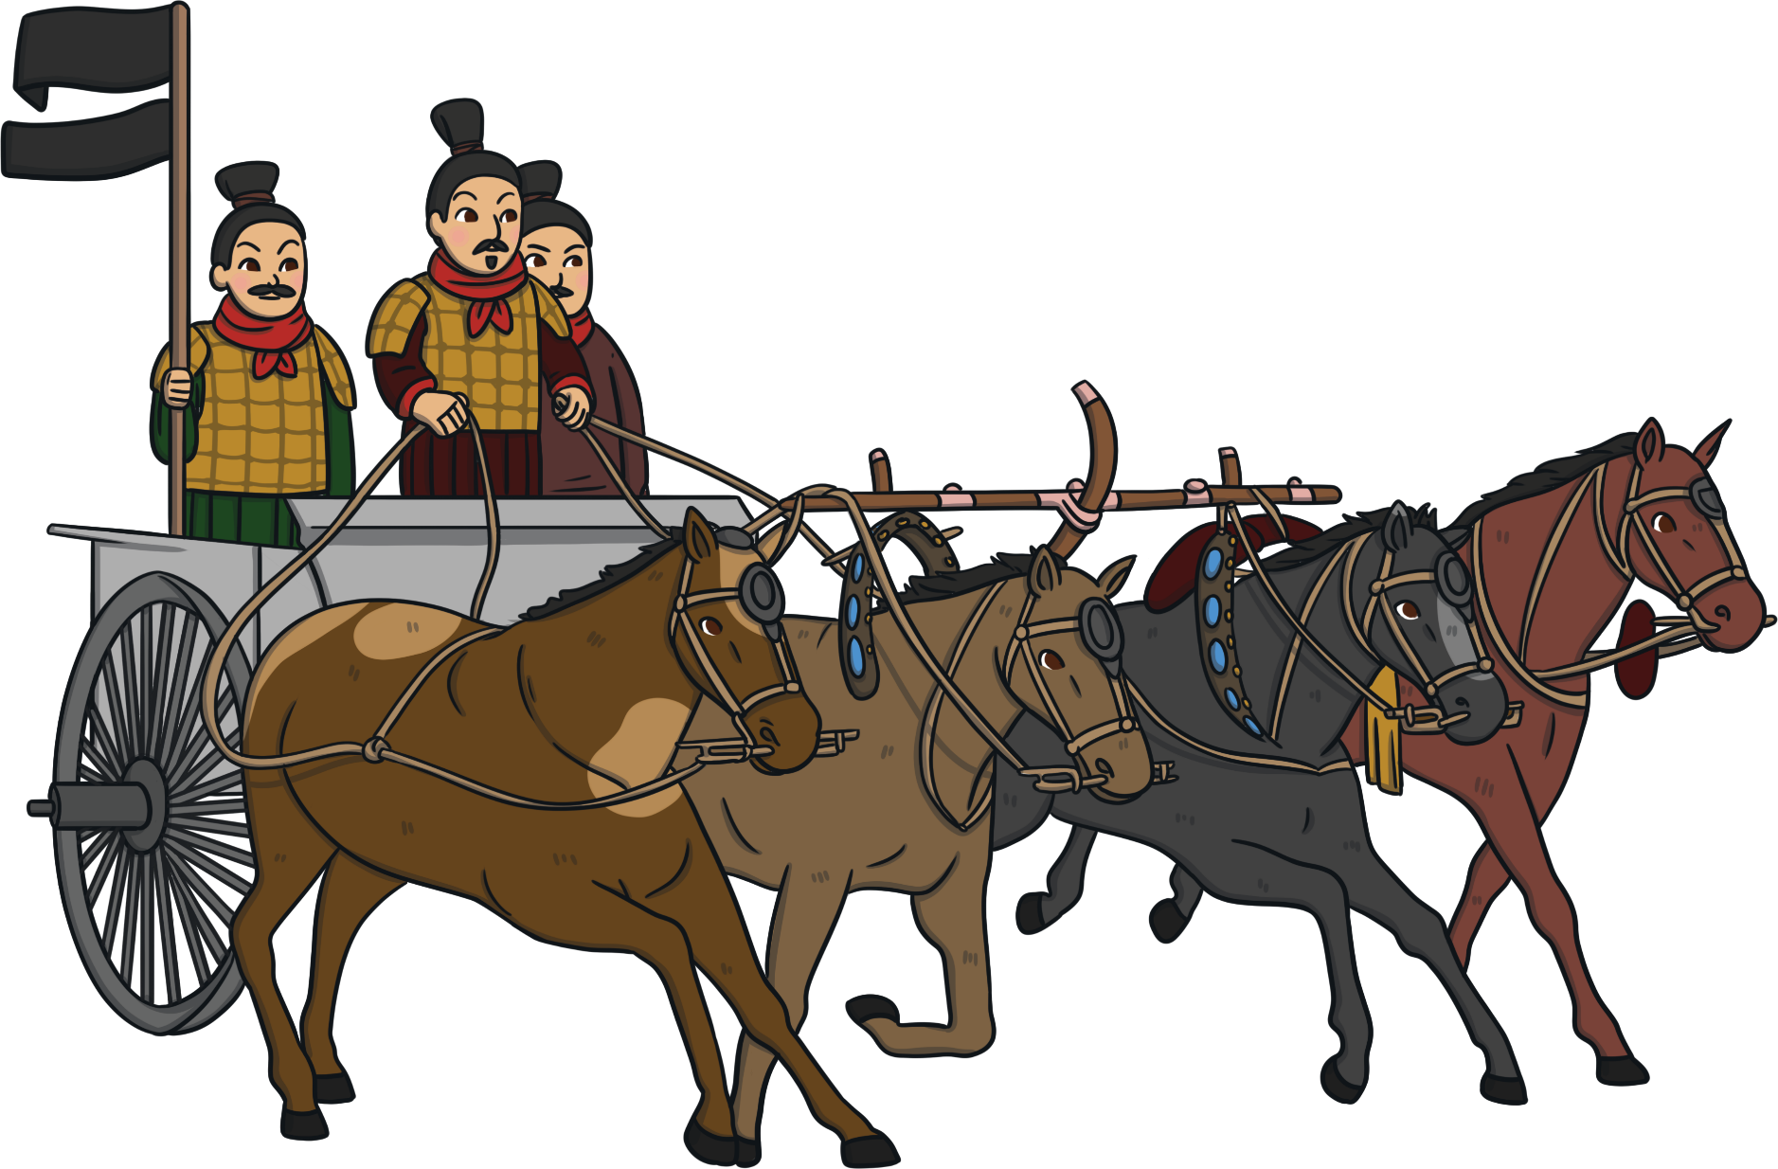
A Formidable Army
The warriors were lined up in order according to their rank.
There were charioteers, cavalry, armoured warriors, officers and generals.
They used different types of weapons, like long spears, daggers and halberds.

Slide 7
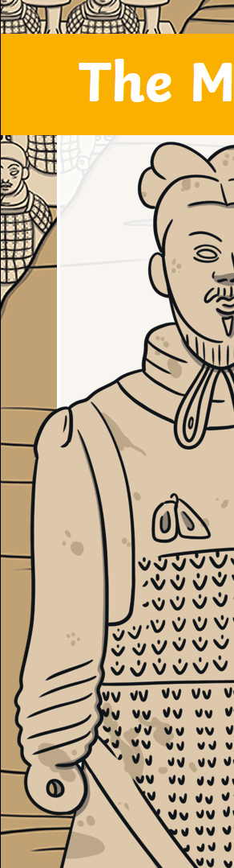
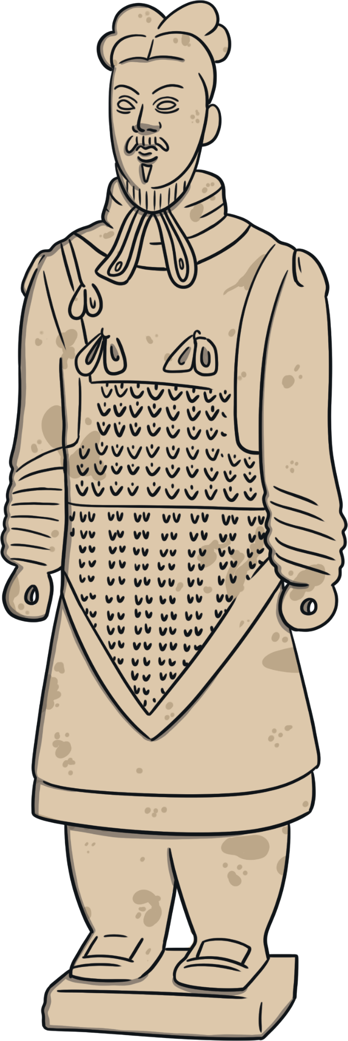
The Making of a Warrior
It took 700 000 workers to make the warriors.
Each part would have been made in separate
moulds. Then fired in a huge kiln before being assembled into a life-size warrior.
Each model has a different expression.
The rivets on their armour stand out.
The kneeling warriors even have tread
marks on the soles of their boots.

Slide 8
The Making of a Warrior
Each warrior weighs around 300kg.
Patches of paint have been found on the warriors. It is believed that they were once painted in bright colours.
Each warrior is stamped with the
name of the person who created it.

Slide 9
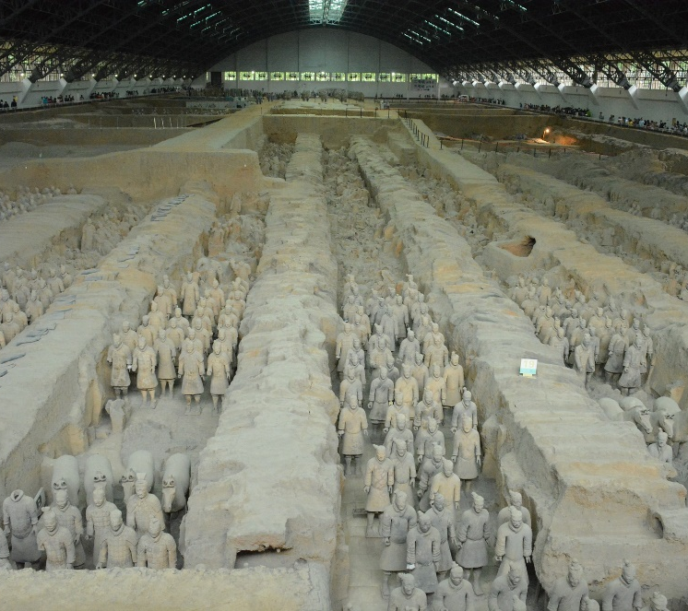
Conservation
In 1979, the Terracotta Army was opened to the public.
In 1987, it became a United Nations Educational, Scientific and Cultural Organisation (Unesco) World Heritage Site and it was given special protection.

